Slide 1

UNIVERSITY INSTITUTE OF COMPUTING
MASTER OF COMPUTER APPLICATIONS
DESIGN AND ANALYSIS OF ALGORITHMS
UNIT-2.1
DISCOVER . LEARN . EMPOWER

Slide 2
Topics to be covered
Greedy Method: General method
Coin Change Problem
Knapsack Problem
Job sequencing with deadlines

Slide 3
Greedy Method
In Greedy method approach, the decision is taken based on current available information without worrying about the effect on the decision in future.
Greedy algorithms build a solution part by part, choosing the next part in such a way, that it gives an immediate benefit. This approach never reconsiders the choices taken previously.
This approach is mainly used to solve optimization problems. Greedy method is easy to implement and quite efficient in most of the cases. Hence, we can say that Greedy algorithm is an algorithmic paradigm based on heuristic that follows local optimal choice at each step with the hope of finding global optimal solution.
In many problems, it does not produce an optimal solution though it gives an approximate (near optimal) solution in a reasonable time.

Slide 4
Components of Greedy Method
Greedy algorithms have the following five components −
A candidate set − A solution is created from this set.
A selection function − Used to choose the best candidate to be added to the solution.
A feasibility function − Used to determine whether a candidate can be used to contribute to the solution.
An objective function − Used to assign a value to a solution or a partial solution.
A solution function − Used to indicate whether a complete solution has been reached.

Slide 5
Greedy Method
Greedy approach can be applied on many algorithms−
Machine scheduling
Fractional Knapsack Problem
Minimum Spanning Tree
Huffman Code
Job Sequencing
Coin Change Problem
Activity Selection Problem

Slide 6
Application of Greedy Method
Greedy approach is used to solve many problems, such as
Finding the shortest path between two vertices using Dijkstra’s algorithm.
Finding the minimal spanning tree in a graph using Prim’s /Kruskal’s algorithm, etc.
Where Greedy Approach Fails
In many problems, Greedy algorithm fails to find an optimal solution, moreover it may produce a worst solution. Problems like Travelling Salesman and Knapsack cannot be solved using this approach.

Slide 7
Knapsack Problem
Given a set of items, each with a weight and a value, determine a subset of items to include in a collection so that the total weight is less than or equal to a given limit and the total value is as large as possible.
The Knapsack Problem is an combinatorial optimization problem. It appears as a subproblem in many, more complex mathematical models of real-world problems. One general approach to difficult problems is to identify the most restrictive constraint, ignore the others, solve a knapsack problem, and somehow adjust the solution to satisfy the ignored constraints.

Slide 8
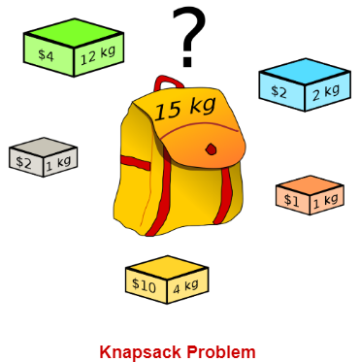
Knapsack Problem
You are given the following-
A knapsack (kind of shoulder bag) with limited weight capacity.
Few items each having some weight and value.
The problem states-
Which items should be placed into the knapsack such that-
The value or profit obtained by putting the items into the knapsack is maximum.
And the weight limit of the knapsack does not exceed.

Slide 9
Knapsack Problem (contd.)
Knapsack problem has the following two variants-
Fractional Knapsack Problem
0/1 Knapsack Problem
In Fractional Knapsack,
As the name suggests, items are divisible here.
We can even put the fraction of any item into the knapsack if taking the complete item is not possible.
It is solved using Greedy Method.

Slide 10
Knapsack Problem (contd.)
Fractional knapsack problem is solved using greedy method in the following steps-
Step-01:
For each item, compute its value(profit) / weight ratio.
Step-02:
Arrange all the items in decreasing order of their value(profit) / weight ratio.
Step-03:
Start putting the items into the knapsack beginning from the item with the highest ratio.
Put as many items as you can into the knapsack.

Slide 11
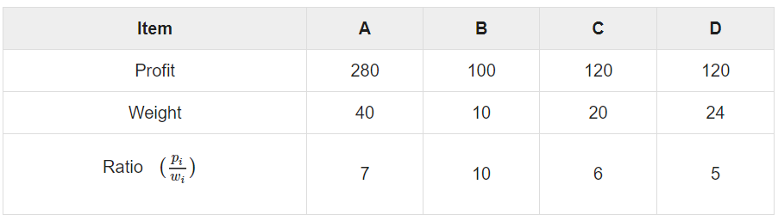

Example-Knapsack Problem
Let us consider that the capacity of the knapsack W = 60 and the list of provided items are shown in the following table −
As the provided items are not sorted based on

Slide 12
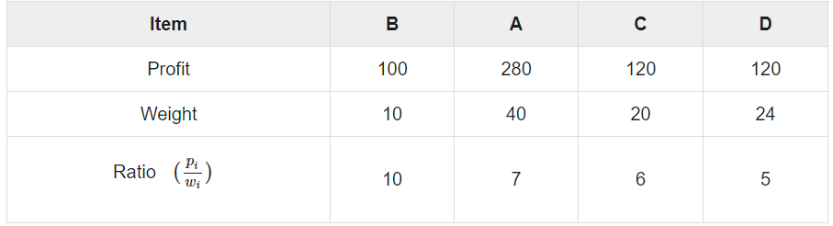
Example-Knapsack Problem
After sorting, the items are as shown in the following table.

Slide 13

Example-Knapsack Problem
After sorting all the items according to .
First all of B is chosen as weight of B is less than the capacity of the knapsack.
Next, item A is chosen, as the available capacity of the knapsack is greater than the weight of A.
Now, C is chosen as the next item.
However, the whole item cannot be chosen as the remaining capacity of the knapsack is less than the weight of C.
Hence, fraction of C (i.e. (60 − 50)/20) is chosen.

Slide 14
Example-Knapsack Problem
Now, the capacity of the Knapsack is equal to the selected items. Hence, no more item can be selected.
The total weight of the selected items is 10 + 40 + 20 * (10/20) = 60
And the total profit is 100 + 280 + 120 * (10/20) = 380 + 60 = 440
This is the optimal solution.
We cannot gain more profit selecting any different combination of items.

Slide 15
Algorithm-Knapsack Problem
Greedy-Fractional-Knapsack (w[1..n], p[1..n], W)
for i = 1 to n
do
x[i] = 0
weight = 0
for i = 1 to n
if weight + w[i] ≤ W then
x[i] = 1
weight = weight + w[i]
else
x[i] = (W - weight) / w[i]
weight = W
break
return x

Slide 16
Analysis-Knapsack Problem
The main time taking step is the sorting of all items in decreasing order of their value / weight ratio.
If the items are already arranged in the required order, then while loop takes O(n) time.
The average time complexity of Quick sort is O(nlogn).
Therefore, total time taken including the sort is O(nlogn).

Slide 17
Applications of Knapsack Problem
In many cases of resource allocation along with some constraint, the problem can be derived in a similar way of Knapsack problem.
Following is a set of example.
Finding the least wasteful way to cut raw materials
portfolio optimization
Cutting stock problems
Space allocation
Machine scheduling

Slide 18
1) https://www.codesdope.com/course/algorithms-greedy-algorithm/
2) Data Structures and Algorithms made easy By Narasimha Karumanchi.
5) The Algorithm Design Manual, 2nd Edition by Steven S Skiena
6) Fundamentals of Computer Algorithms - Horowitz and Sahani
References

Slide 19
THANK YOU
For any Queries-
E-Mail: gurpreetkaur.uic@cumail.in

